Slide 1
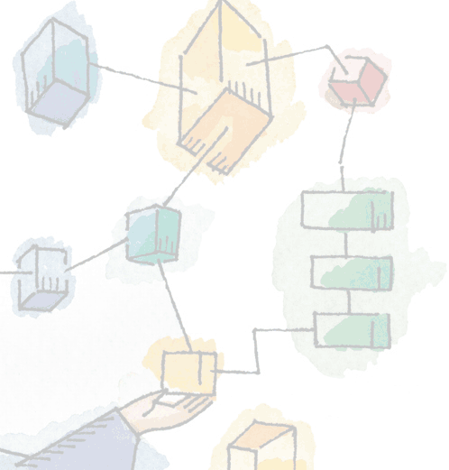
Chapter 1
Computer System Overview
Operating Systems:
Internals and Design Principles,
William Stallings

Slide 2
Operating System
Exploits the hardware resources of one or more processors
Provides a set of services to system users
Manages secondary memory and I/O devices

Slide 3
Basic Elements
Main Memory
  Volatile
  Referred to as real memory or primary memory

Slide 4
Basic Elements
I/O Modules
  Secondary Memory Devices
  Communications equipment
  Terminals
System bus
  Communication among processors, main memory, and I/O modules

Slide 5
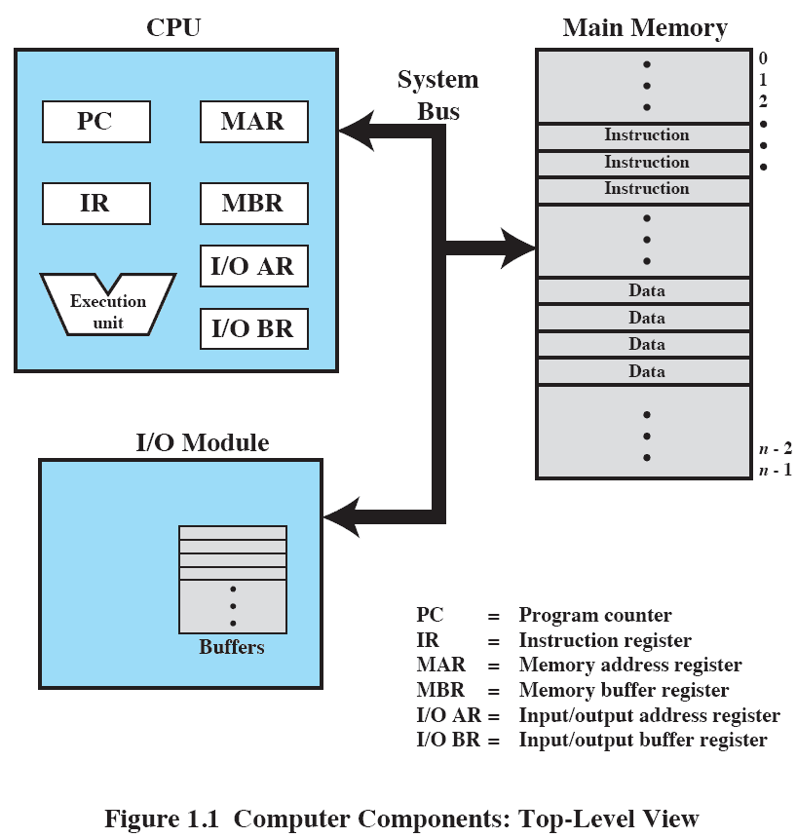
Computer Components: Top-Level View

Slide 6
Instruction Execution
Two steps
  Processor reads (fetches) instructions from memory
  Processor executes each instruction

Slide 7
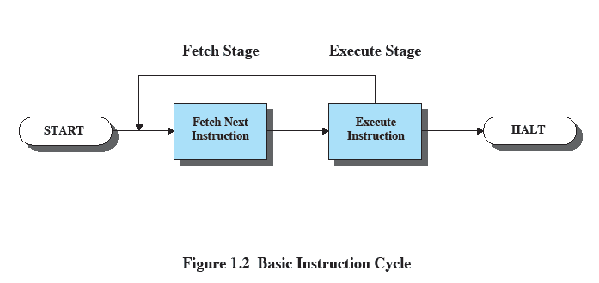
Basic Instruction Cycle

Slide 8
Interrupts
Interrupt the normal sequencing of the processor
Most I/O devices are slower than the processor
  Processor must pause to wait for device

Slide 9
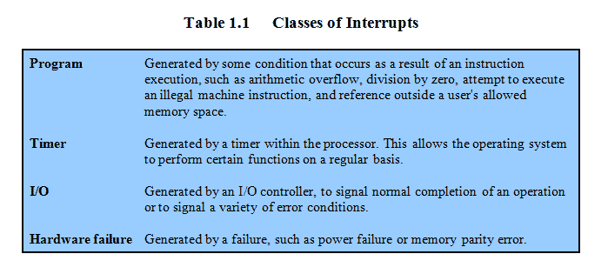
Classes of Interrupts

Slide 10
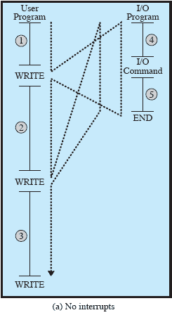
Program Flow of Control

Slide 11
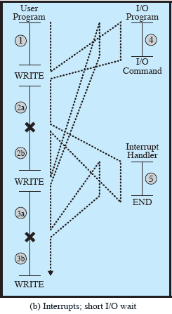
Program Flow of Control
Notes:
X marks the interrupt

Slide 12
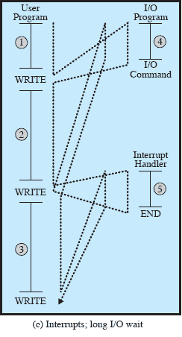
Program Flow of Control
Notes:
The interrupt does not get back before the program calls the I/O again – thus it will block at that second I/O.

Slide 13
Interrupt Stage
Processor checks for interrupts
If interrupt
  Suspend execution of program
  Execute interrupt-handler routine

Slide 14
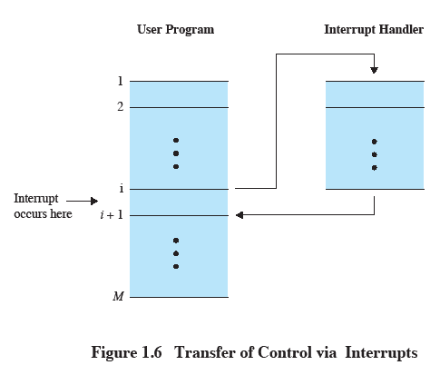
Transfer of Control via Interrupts

Slide 15
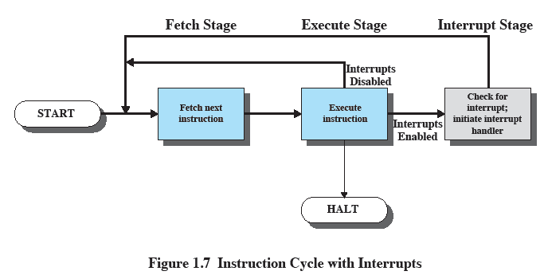
Instruction Cycle with Interrupts

Slide 16
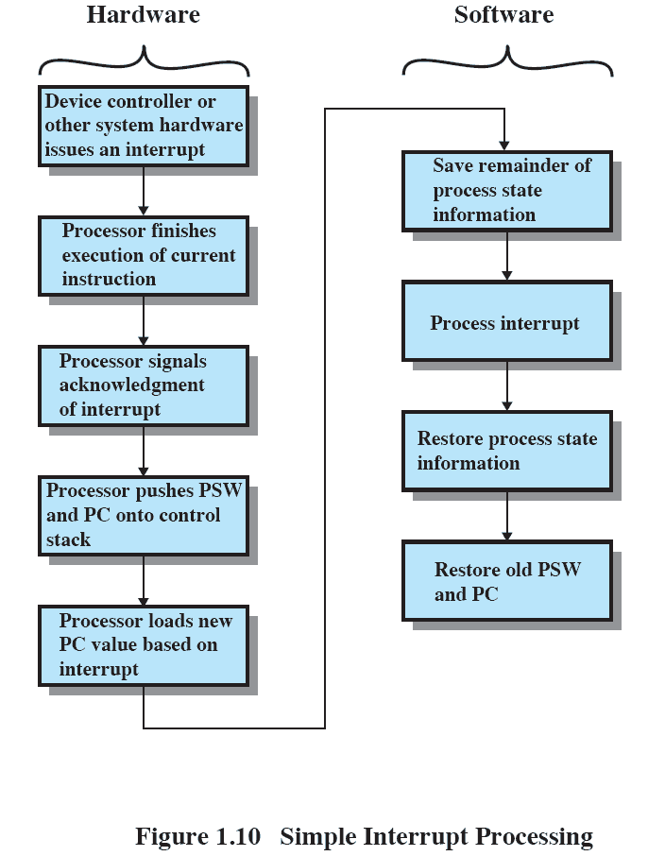
Simple Interrupt Processing

Slide 17
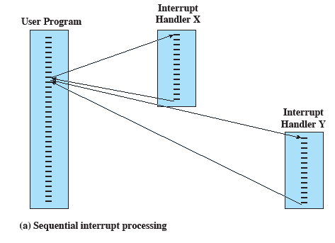
Sequential Interrupt Processing

Slide 18
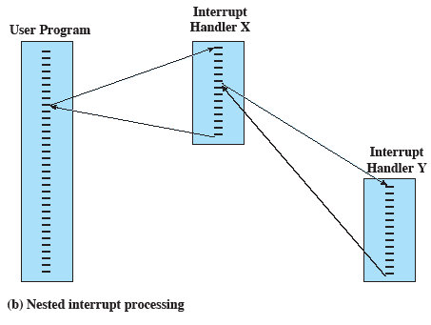
Nested Interrupt Processing

Slide 19
Multiprogramming
Processor has more than one program to execute
The sequence in which programs are executed depend on their relative priority and whether they are waiting for I/O
After an interrupt handler completes, control may not return to the program that was executing at the time of the interrupt

Slide 20
Memory Hierarchy
Faster access time, greater cost per bit
Greater capacity, smaller cost per bit
Greater capacity, slower access speed

Slide 21
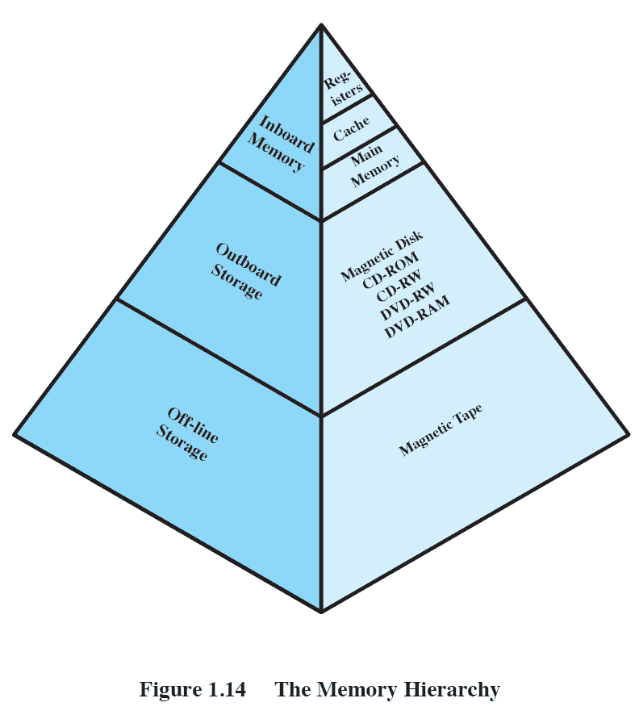
The Memory Hierarchy

Slide 22
Going Down the Hierarchy
Decreasing cost per bit
Increasing capacity
Increasing access time
Decreasing frequency of access to the memory by the processor

Slide 23
Secondary Memory
Auxiliary memory
External
Nonvolatile
Used to store program and data files

Slide 24
Cache Memory
Processor speed faster than memory access speed
Exploit the principle of locality with a small fast memory

Slide 25
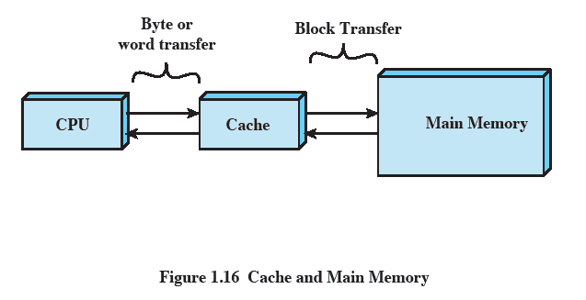
Cache and Main Memory

Slide 26
Cache Principles
Contains copy of a portion of main memory
Processor first checks cache
If desired data item not found, relevant block of memory read into cache
Because of locality of reference, it is likely that future memory references are in that block

Slide 27
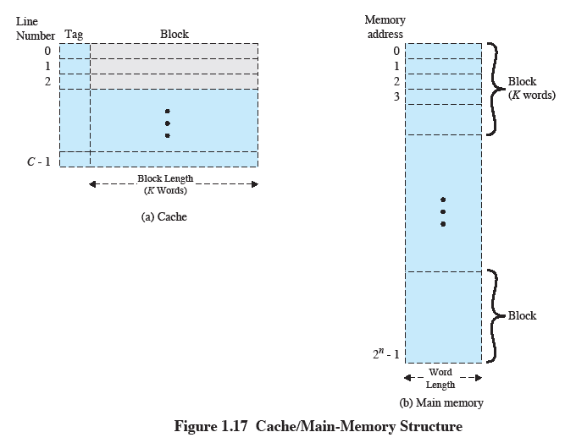
Cache/Main-Memory Structure

Slide 28
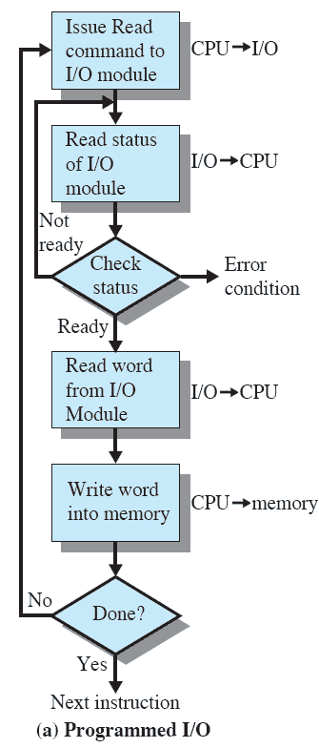
Programmed I/O
I/O module performs the action, not the processor
Sets the appropriate bits in the I/O status register
No interrupts occur
Processor checks status until operation is complete

Slide 29
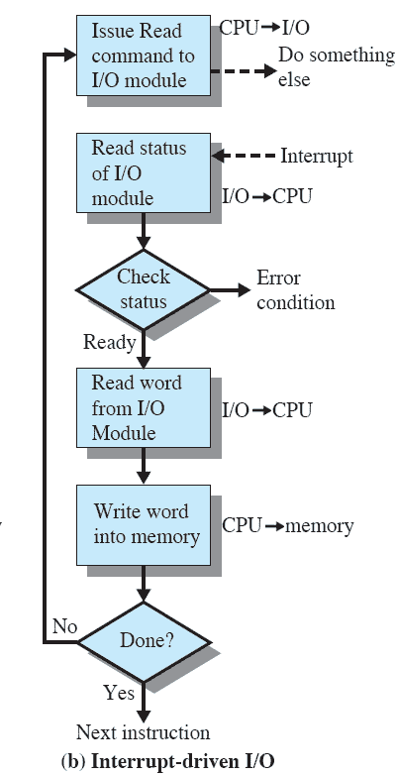
Interrupt-Driven I/O
Processor is interrupted when I/O module ready to exchange data
Processor saves context of program executing and begins executing interrupt-handler

Slide 30
Interrupt-Driven I/O
No needless waiting
Consumes a lot of processor time because every word read or written passes through the processor

Slide 31
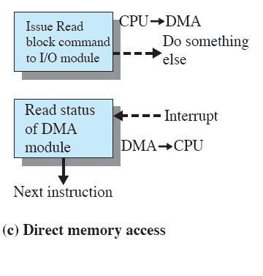
Direct Memory Access
Transfers a block of data directly to or from memory
An interrupt is sent when the transfer is complete
More efficient

